Slide 1
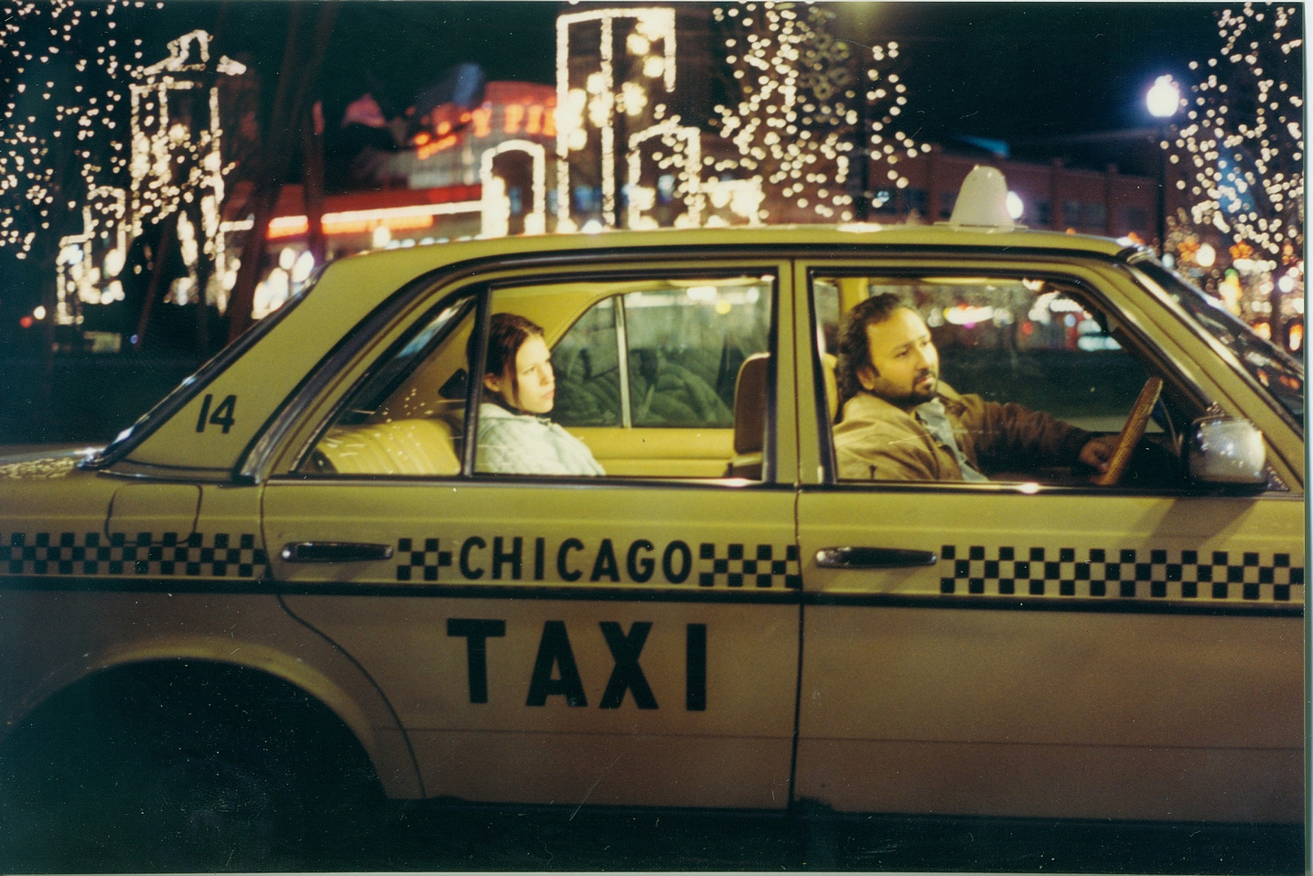

Presented by : Endah Rakhmawati
Chicago Taxi Trip
Data Series 10
Data Engineering

Slide 2
Dataset
bigquery-public-data.chicago_taxi_trips.taxi_trips

Slide 3
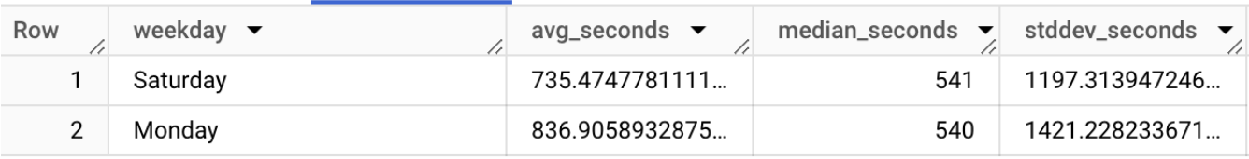
Task 1
Calculate the mean, median and standard deviation of trip duration (trip_seconds) for trips made on Mondays and Saturdays. Compare the two results that day.
Output :

Slide 4
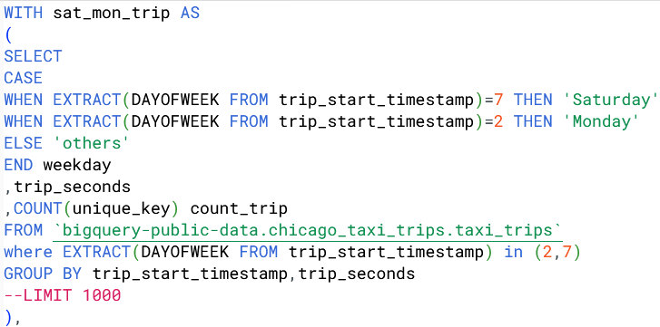
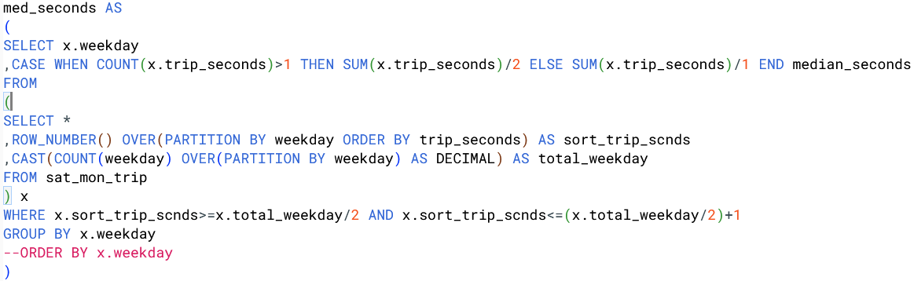
SQL Query

Slide 5
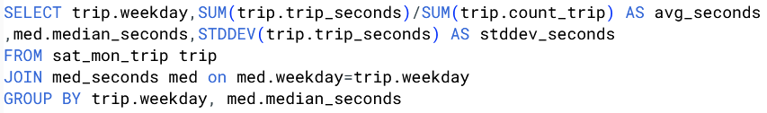
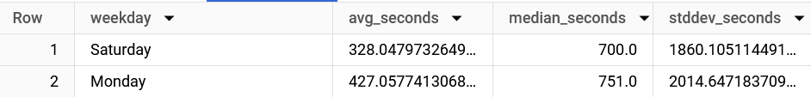
SQL Query
Output :

Slide 6
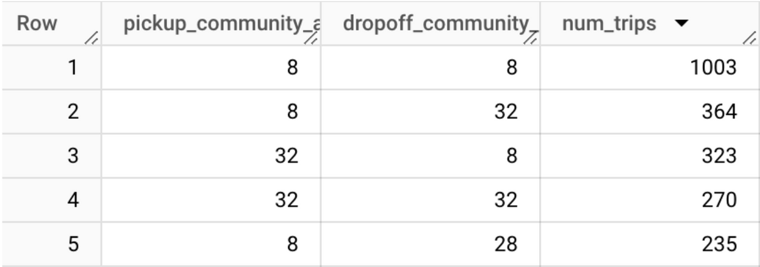
Task 2
Find five routes (from initial community_area to destination community_area) with the largest number of trips in 2023.
Output :

Slide 7
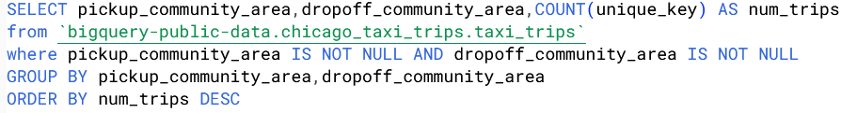
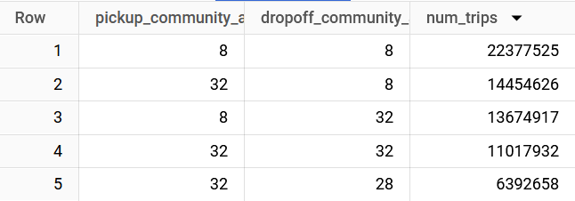
SQL Query
Output :

Slide 8
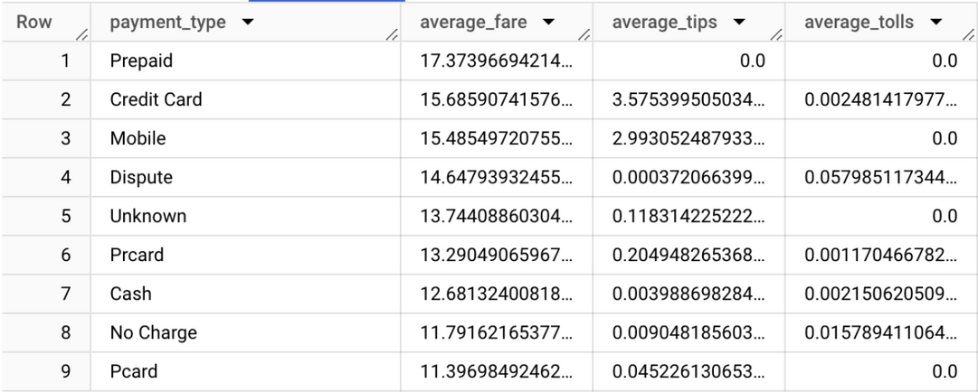
Task 3
Compare the average cost of a taxi trip (fare, tips, and taxes) based on payment methods in 2019.
Output :

Slide 9
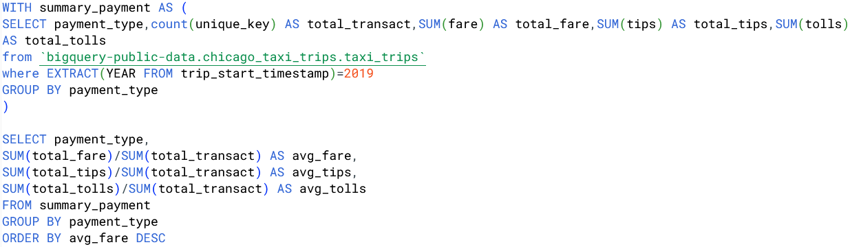
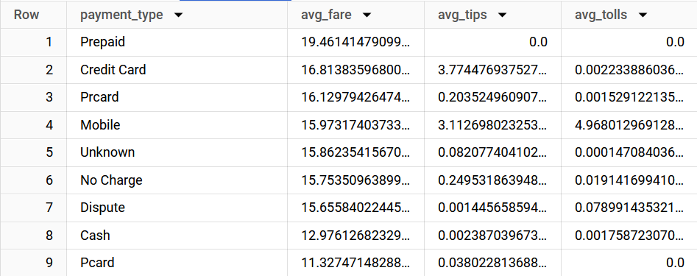
SQL Query
Output :

Slide 10

Thank You
endahen12@gmail.com

